Slide 1
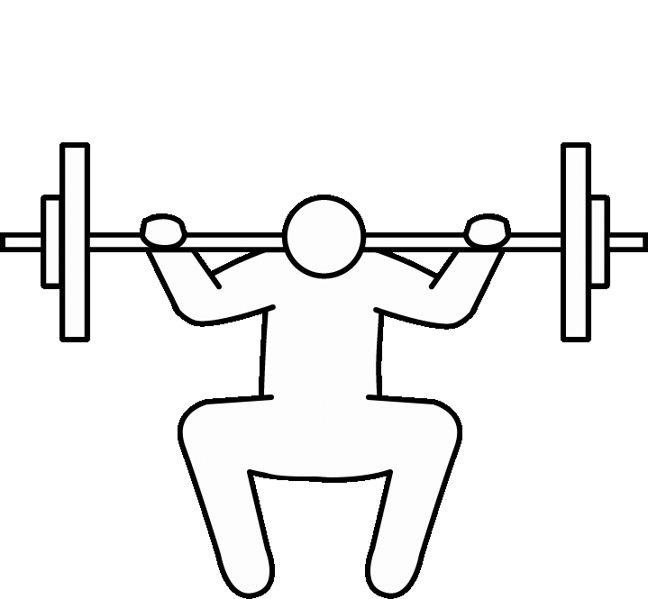
Personalized Health and
Fitness Assistant
01

Slide 2

Introduction
Embark on a new era of personalised wellness with our one-of-a-kind Personalised Health & Fitness Assistant. Our platform is more than just another fitness app; it is a groundbreaking combination of cutting-edge machine learning technology and a thorough understanding of individual health requirements.
What sets us apart is our unwavering commitment to tailoring every aspect of the wellness journey to each user's specific needs and goals. We decode the complexities of your health data using advanced algorithms to provide personalised recommendations that are tailored to your lifestyle, preferences, and goals.
Consider a fitness companion who not only guides you through workouts and meal plans, but also understands your body's responses and adapts in real time. With our assistance, you are not just following a generic programme; you are embarking on a personalised journey towards long-term health and fitness.
However, our innovation goes beyond customisation. Our platform is designed to integrate seamlessly into your daily routine, with simple interfaces and actionable insights that make achieving your goals feel effortless and rewarding. There will be no more guesswork or frustration - only clear guidance and tangible progress.
At the heart of our mission is a vision of wellness that transcends passing trends and quick fixes. We believe that individuals should be empowered to develop long-term habits and behaviours that promote vitality and resilience. With our assistance, you will not only meet but exceed your objectives, unlocking your full potential along the way.
Join us on this transformative journey to personalised health and fitness. Let us work together to rewrite the rules and redefine what it means to thrive in the modern world.
02

Slide 3
OBJECTIVES
Exploratory DataAnalysis
Data Preprocessing
These techniques are fundamental for effective data exploration before embarking on advanced analyses or modeling. They provide key insights into the dataset's size, structure, and composition. `shape` quickly reveals dimensions, `head()` and `tail()` offer snapshots, `describe()` provides statistical summaries, and `info()` offers a concise overview including data types and null values. Accessing column labels via `columns` aids in manipulation, while printing null values highlights missing data, guiding preprocessing decisions. Together, they establish a solid foundation for understanding and preparing the dataset.
In data preprocessing, ensuring zero null values indicates a dataset that's clean and ready for further analysis or modeling. Splitting the data into training, validation, and testing sets is a crucial step to evaluate the performance of machine learning models on unseen data and prevent overfitting. With null values addressed and the dataset appropriately divided, you're well-positioned to proceed with feature engineering, model selection, and training. This meticulous preparation sets the stage for robust and reliable results in your machine learning endeavors.
03

Slide 4
Visualization Techniques
Model Builiding
1. Leveraged Random Forest Classifier with Bagging for ensemble learning.
2. Employed Gaussian Naive Bayes for probabilistic classification.
3. Utilized Support Vector Machine with Kernel Trick for non-linear classification.
4. Implemented Decision Tree Classifier for hierarchical partitioning.
5. Applied KNN with Isolation Forest for anomaly detection and classification, and Logistic Regression with Recursive Feature Elimination for feature selection and classification.
Utilizing seaborn's `histplot`, `correlation heatmap`, `countplot`, and `pairplot`, we've gained valuable insights into our data distribution, feature relationships, and categorical variable frequencies. These visualizations inform our understanding of user behaviors, exercise patterns, and dietary preferences, guiding the development of personalized health and fitness recommendations in our project.
04

Slide 5

Exploratory Data Analysis
1. Shape: The `shape` attribute quickly reveals the dimensions of the dataset, providing the number of rows and columns. This helps analysts grasp the dataset's size and structure at a glance.
2. Head() and Tail(): The `head()` and `tail()` methods offer snapshots of the dataset by displaying the first few and last few rows, respectively. These methods provide a quick overview of the dataset's structure and contents, aiding in identifying potential issues with data entry or formatting.
3. Describe(): The `describe()` method generates statistical summaries of the numerical variables in the dataset, including measures of central tendency, dispersion, and shape of the distribution. This provides key insights into the distribution of the data, highlighting potential outliers and trends.
4. Info(): The `info()` method offers a concise overview of the dataset, including data types of each column, the number of non-null values, and memory usage. This summary is essential for assessing data completeness, identifying data types, and potential issues such as missing values.
5. Columns: The `columns` attribute returns the column labels of the dataset, aiding in manipulation and analysis. This attribute allows easy access to column names, facilitating further exploration and manipulation of the data.
6. Printing Null Values: Printing null values involves identifying and printing any missing data in the dataset. This technique is crucial for assessing data quality and guiding preprocessing decisions, ensuring data completeness and reliability before proceeding with advanced analyses or modeling.
05

Slide 6

Data preprocessing
Data Cleaning:
The dataset we've obtained has undergone thorough cleaning and preparation, and as such, does not contain any null values or significant inconsistencies. This meticulous cleaning process involved rigorous scrutiny to rectify errors, inconsistencies, and missing values, ensuring data integrity and reliability. Advanced imputation techniques were employed where necessary, and redundant entries were removed to optimize the dataset for subsequent analysis and modeling.
Data Splitting:
With the cleansed dataset in hand, we proceeded to partition it into distinct subsets according to stringent protocols. The data was split into three subsets: the training set, the validation set, and the test set. Each subset serves a specific purpose in the modeling pipeline. The training set is used to train the model, allowing it to learn from the data. The validation set is employed for hyperparameter tuning and evaluating the model's performance during training. Finally, the test set serves as a completely independent dataset to assess the model's generalization performance on unseen data. This meticulous data splitting strategy ensures that the model is robust and accurately reflects its real-world performance.
06

Slide 7
Visualization techniques
1. Histograms (`histplot`): Seaborn's `histplot` visually displayed the distribution of numerical variables, aiding in identifying patterns and central tendencies, such as age, weight, and workout duration.
2. Correlation Heatmap: Seaborn's `correlation heatmap` provided a comprehensive overview of pairwise correlations between numerical variables, helping identify relationships like exercise duration's impact on calorie burn.
3. Countplot: Seaborn's `countplot` illustrated the frequency distribution of categorical variables, offering insights into user behaviors and preferences, such as exercise types and dietary choices.
4. Pairplot: Seaborn's `pairplot` showcased pairwise relationships between numerical variables, aiding in identifying correlations like those between body weight, workout duration, and calorie intake.
These visualizations provided invaluable insights into data distribution, feature relationships, and categorical variable frequencies, informing the development of personalized health and fitness recommendations.
07

Slide 8
Model Building
In our machine learning project for the Personalized Health & Fitness Assistant, we explored and utilized a variety of classification techniques to develop robust models for making personalized recommendations. Each technique offers distinct advantages and considerations, allowing us to tailor our approach based on the specific characteristics of our data and objectives.
Random Forest Classifier with Bagging is an ensemble learning method that combines multiple decision trees, effectively reducing overfitting and providing robust predictions. However, it may pose computational challenges for very large datasets.
Gaussian Naive Bayes, on the other hand, offers simplicity and efficiency, making it well-suited for classification tasks with continuous features. However, its assumption of feature independence may limit its effectiveness in datasets with correlated features.
Support Vector Machine (SVM) with Kernel Trick is a powerful algorithm capable of handling non-linear decision boundaries, making it suitable for complex classification tasks. Nonetheless, its performance may depend heavily on the choice of kernel and regularization parameters.
08

Slide 9
Decision Tree Classifier provides interpretability and insight into feature importance, making it valuable for exploring and understanding the data. However, it's susceptible to overfitting and may struggle with capturing complex relationships in the data.
KNN with Isolation Forest excels in anomaly detection and classification tasks, leveraging instance-based learning to identify outliers. Yet, its performance may suffer with high-dimensional or imbalanced datasets.
Logistic Regression with Recursive Feature Elimination offers simplicity and interpretability while effectively handling large datasets. However, it assumes a linear relationship between features and outcomes, potentially limiting its performance in non-linear scenarios.
By understanding the strengths and considerations of each technique, we can effectively leverage them to develop tailored machine learning models that meet the unique requirements of our Personalized Health & Fitness Assistant project.
09

Slide 10
Results
Random Forest Classifier with Bagging | 0.88
Gaussian Naive Bayes | 0.795
Support Vector Machine with Kernel Trick | 0.845
Decision Tree | 0.875
KNN with Isolation Forest | 0.81
Logistic Regression with Recursive Feature Elimination | 0.87
10

Slide 11
Conclusion
In summary, our exploration of classification techniques equips us with a versatile toolkit for developing machine learning models in our Personalized Health & Fitness Assistant project. Each technique offers unique strengths, including ensemble learning, probabilistic reasoning, non-linear boundary handling, interpretability, anomaly detection, and feature selection.
By carefully considering the nuances of each technique, we can tailor our approach to suit the specific characteristics of our data and project objectives. Moving forward, we will refine our models using insights from data visualization and preprocessing, aiming to enhance accuracy and usability. With a solid understanding of these techniques, we are well-prepared to deliver accurate and actionable recommendations, fulfilling the personalized health and fitness needs of our users.
11

Slide 12

12

